Slide 1

Heaven’s light is our guide
Rajshahi University of Engineering & Technology
Department of Mechatronics Engineering
CSE 2188
Software Engineering Sessional
Wallet App
Group No. 2
25-07-2022

Slide 2
Group Members
S M Shafayet Jamil (1908006)
Rehnuma Taskin (1908007)
Sayeed Abdullah (1908008)
M. Nasimul huq (1908009)
Laboni Mostofa (1908010)
Under the Supervision of
Md. Faisal Rahman Badal,Lecturer,Dept.of Mechatronics Engineering ,RUET
Md. Mehedi Hasan,Lecturer,Dept.of Mechatronics Engineering ,RUET
25-07-2022 CSE 2188 : Software Engineering Sessional

Slide 3
Outlines
Tools
Previous Activities
Add transaction Function
See Transaction Function
GUI Discussion
Final Output
Conclusion
25-07-2022 CSE 2188 : Software Engineering Sessional

Slide 4


Tools
25-07-2022 CSE 2188 : Software Engineering Sessional

Slide 5
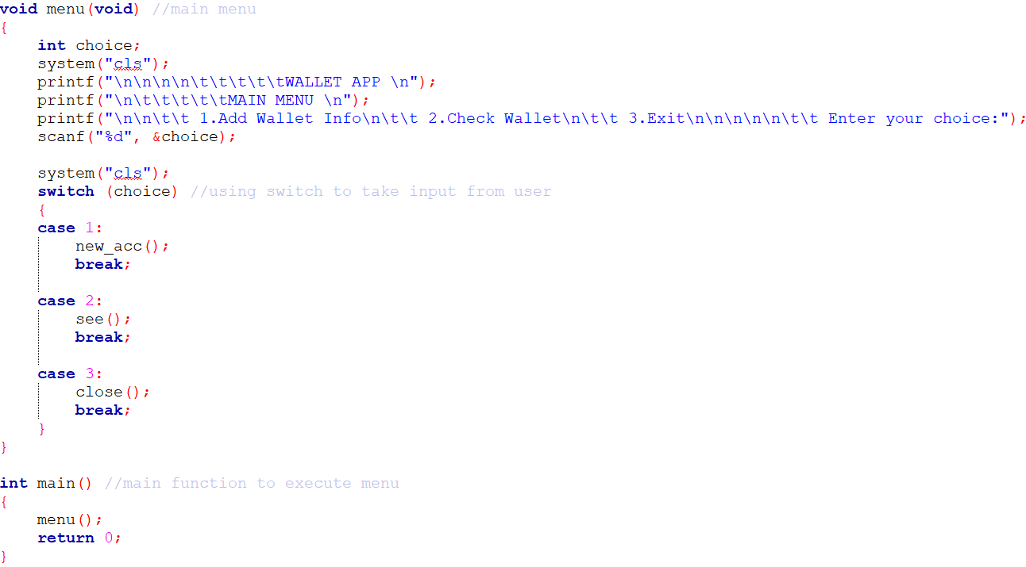
Previous Activities
Main Menu
25-07-2022 CSE 2188 : Software Engineering Sessional

Slide 6
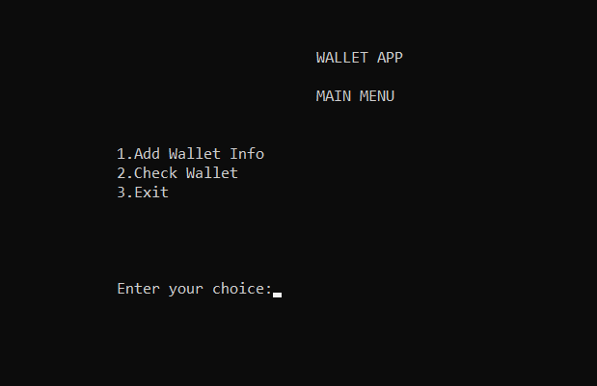
OUTPUT
25-07-2022 CSE 2188 : Software Engineering Sessional

Slide 7
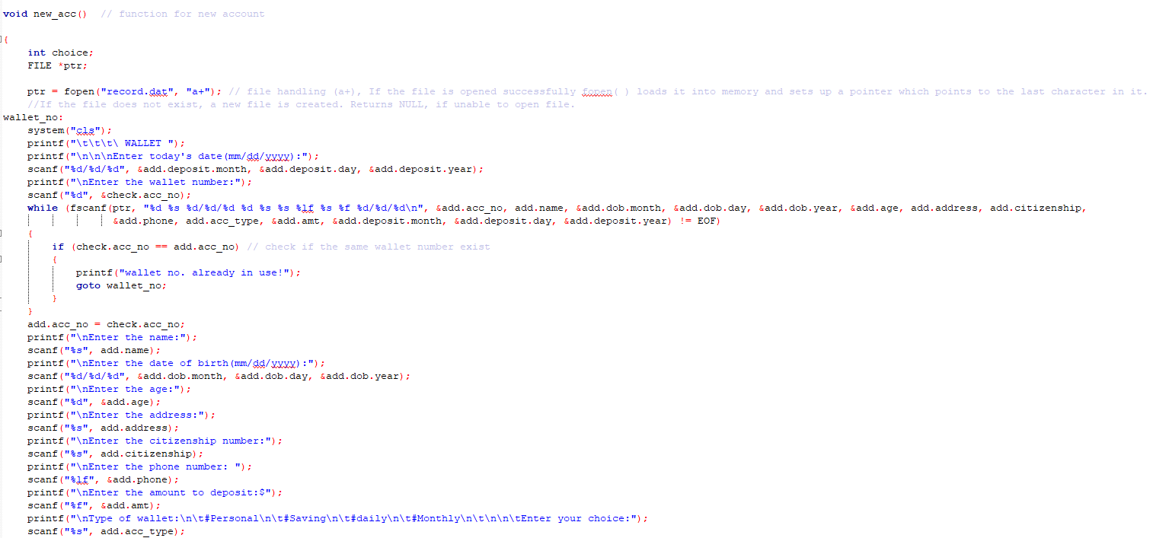
Previous Activities
Create New Wallet
25-07-2022 CSE 2188 : Software Engineering Sessional

Slide 8
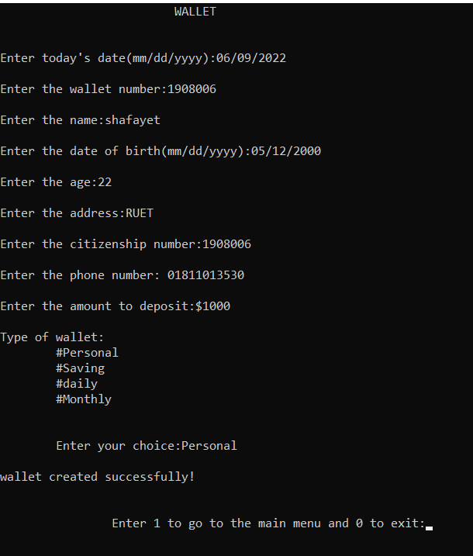
OUTPUT
25-07-2022 CSE 2188 : Software Engineering Sessional

Slide 9
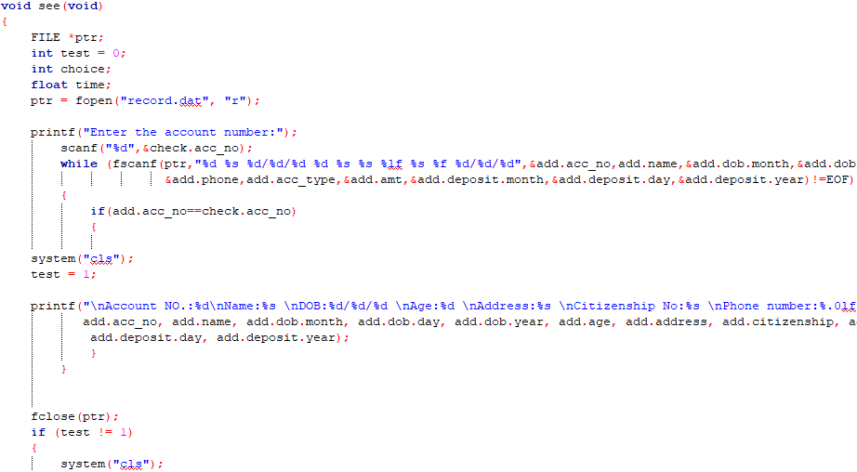
Previous Activities
Check Wallet Information
25-07-2022 CSE 2188 : Software Engineering Sessional

Slide 10
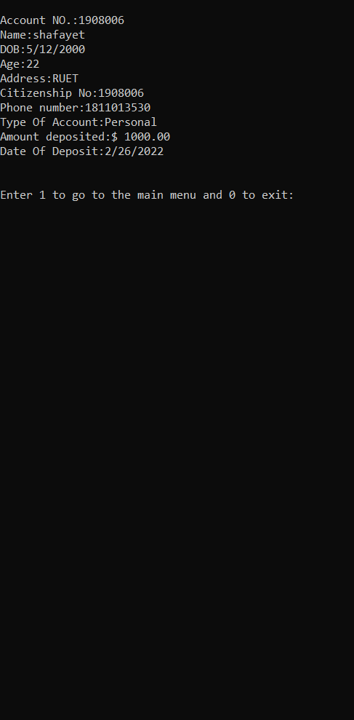
OUTPUT
25-07-2022 CSE 2188 : Software Engineering Sessional

Slide 11
Future Plans
1.Add Transaction Function
2. See Transaction Function
4.Create GUI Using QT
25-07-2022 CSE 2188 : Software Engineering Sessional

Slide 12
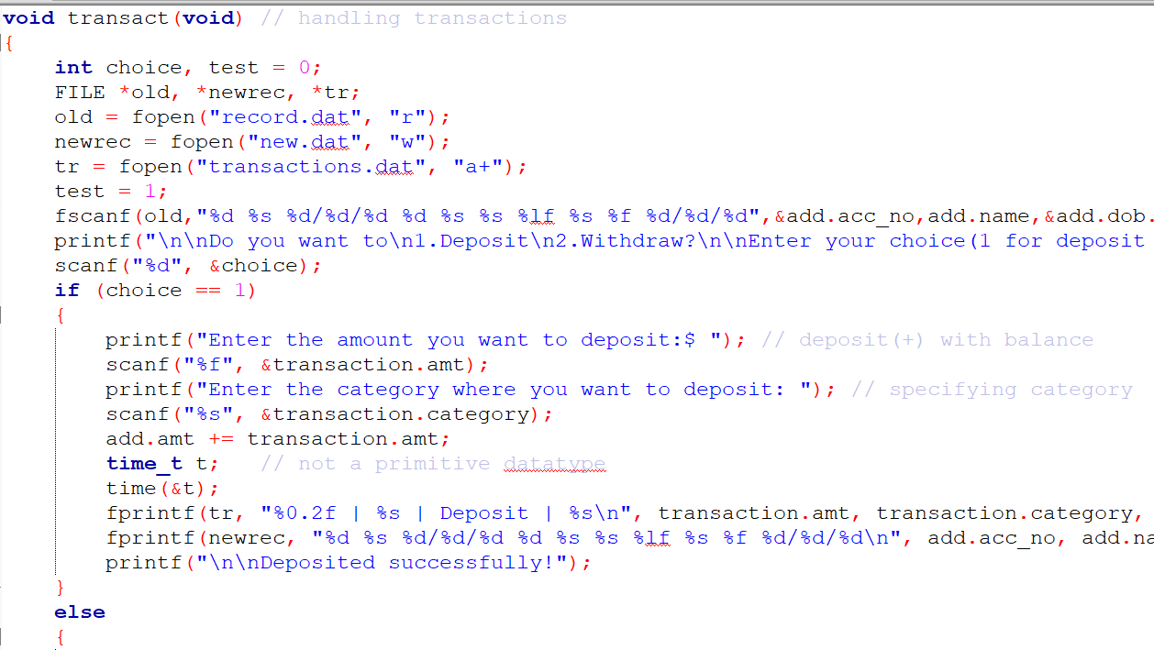
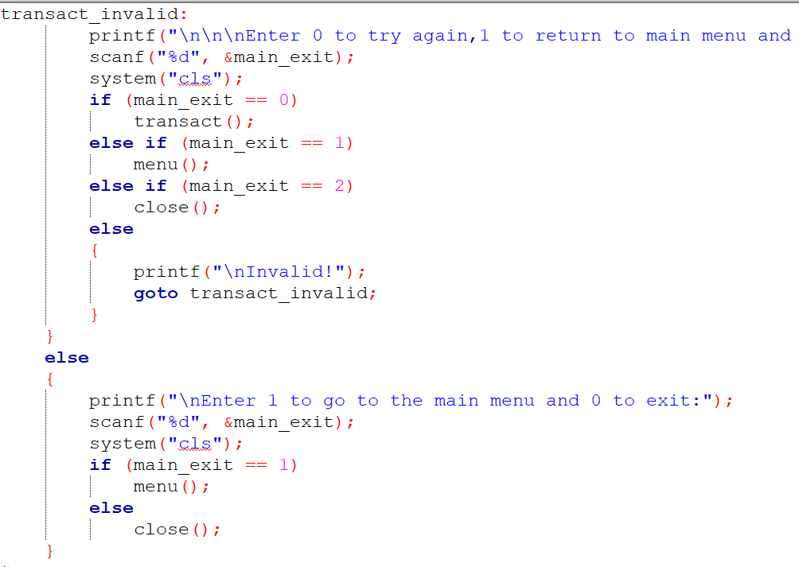
Add Transaction Function
25-07-2022 CSE 2188 : Software Engineering Sessional

Slide 13
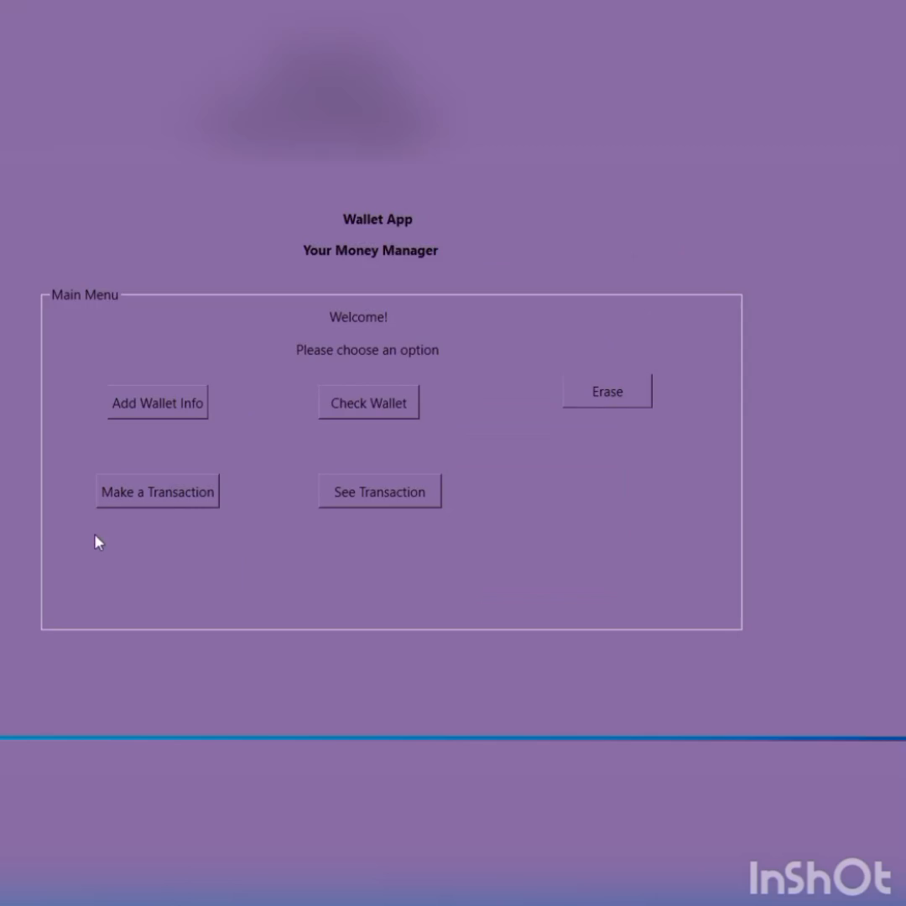
OUTPUT
25-07-2022 CSE 2188 : Software Engineering Sessional

Slide 14
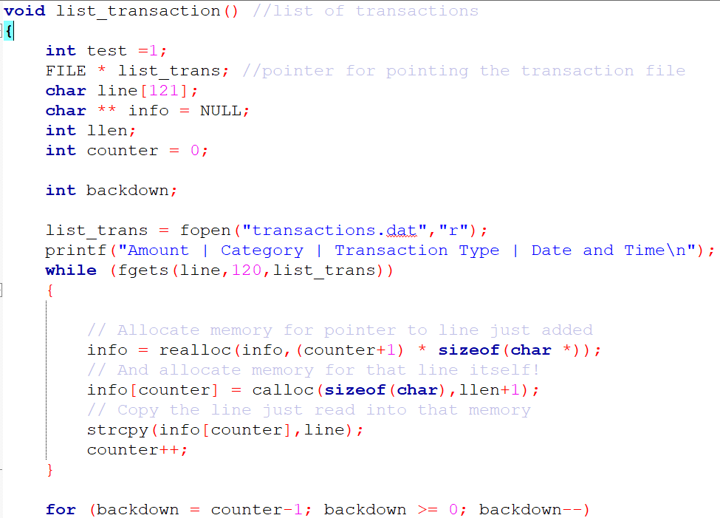
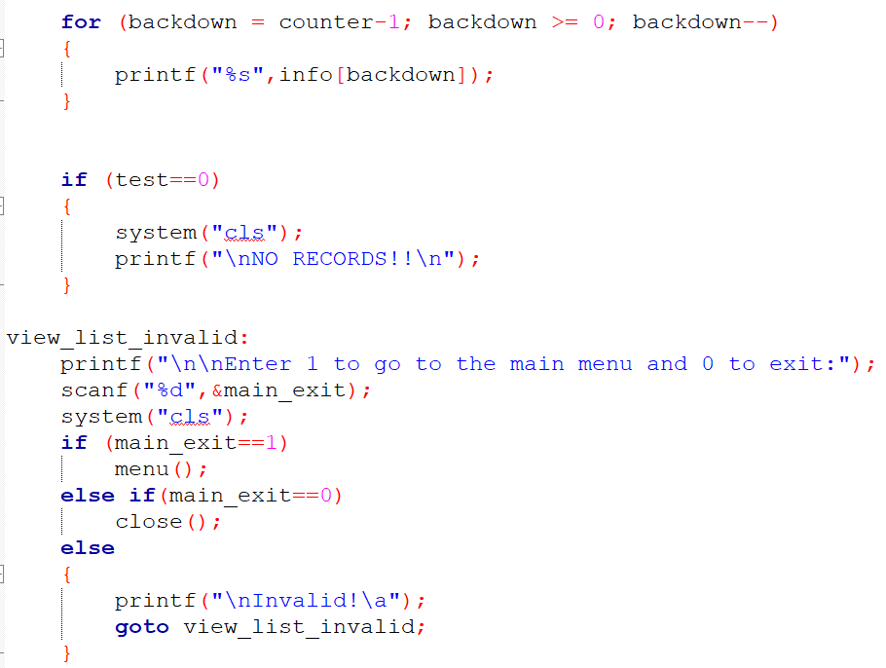
See Transaction Function
25-07-2022 CSE 2188 : Software Engineering Sessional

Slide 15
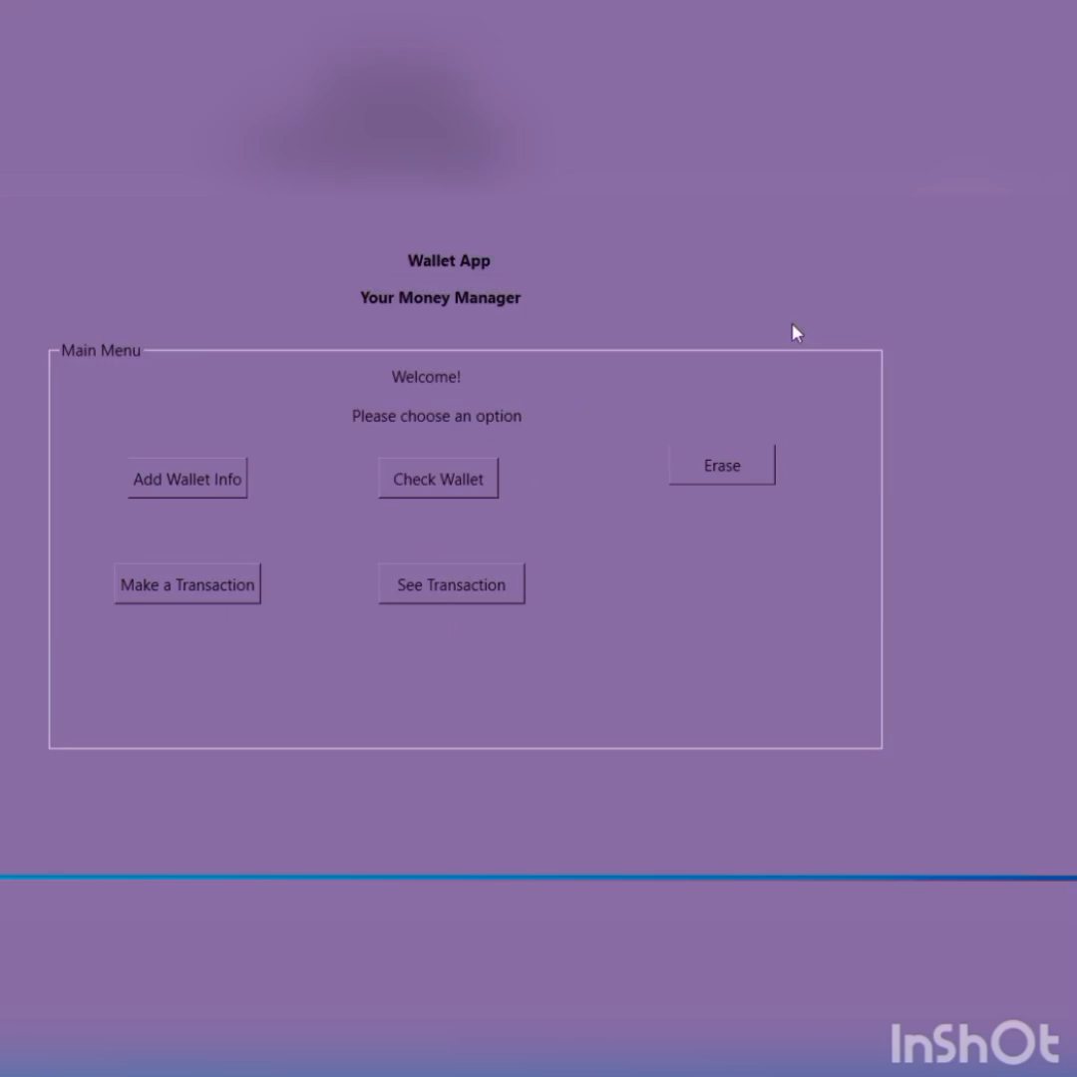
OUTPUT
25-07-2022 CSE 2188 : Software Engineering Sessional

Slide 16
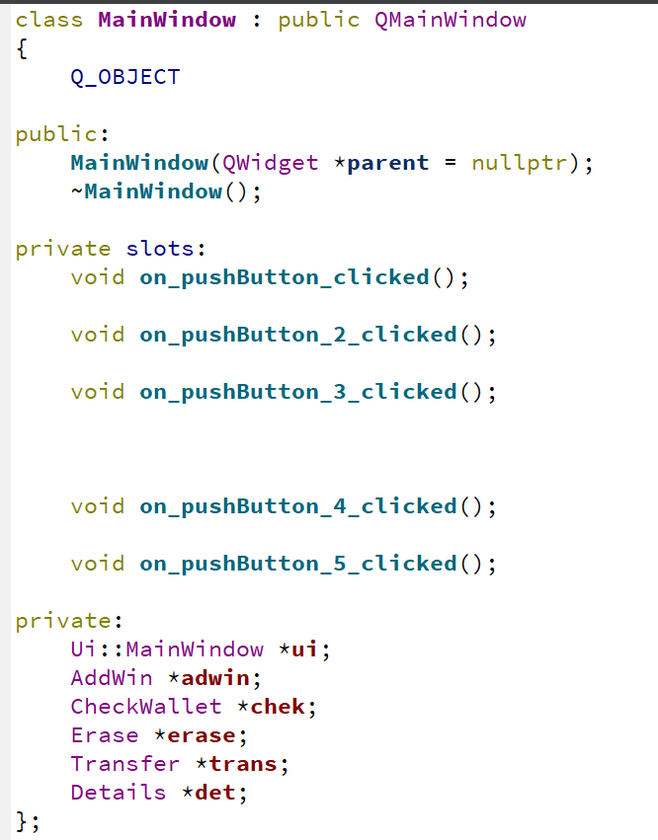
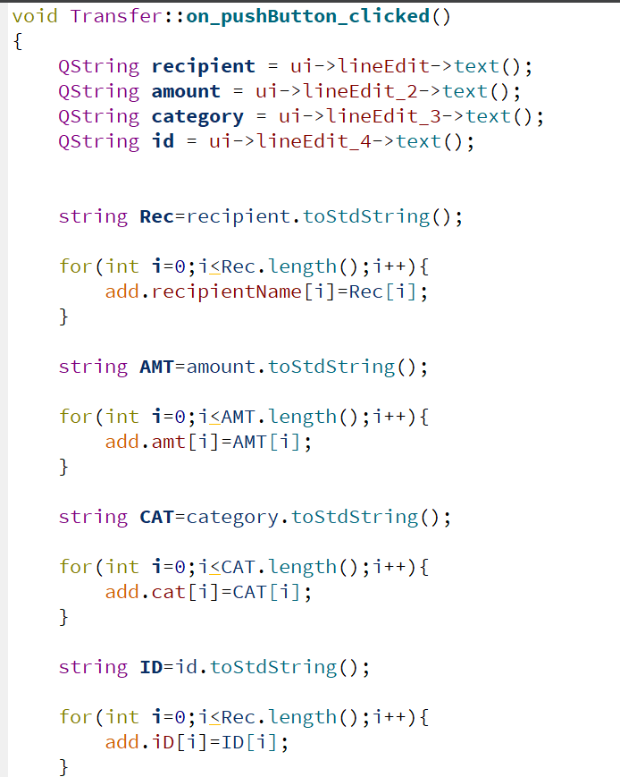
GUI Discussion
25-07-2022 CSE 2188 : Software Engineering Sessional

Slide 17
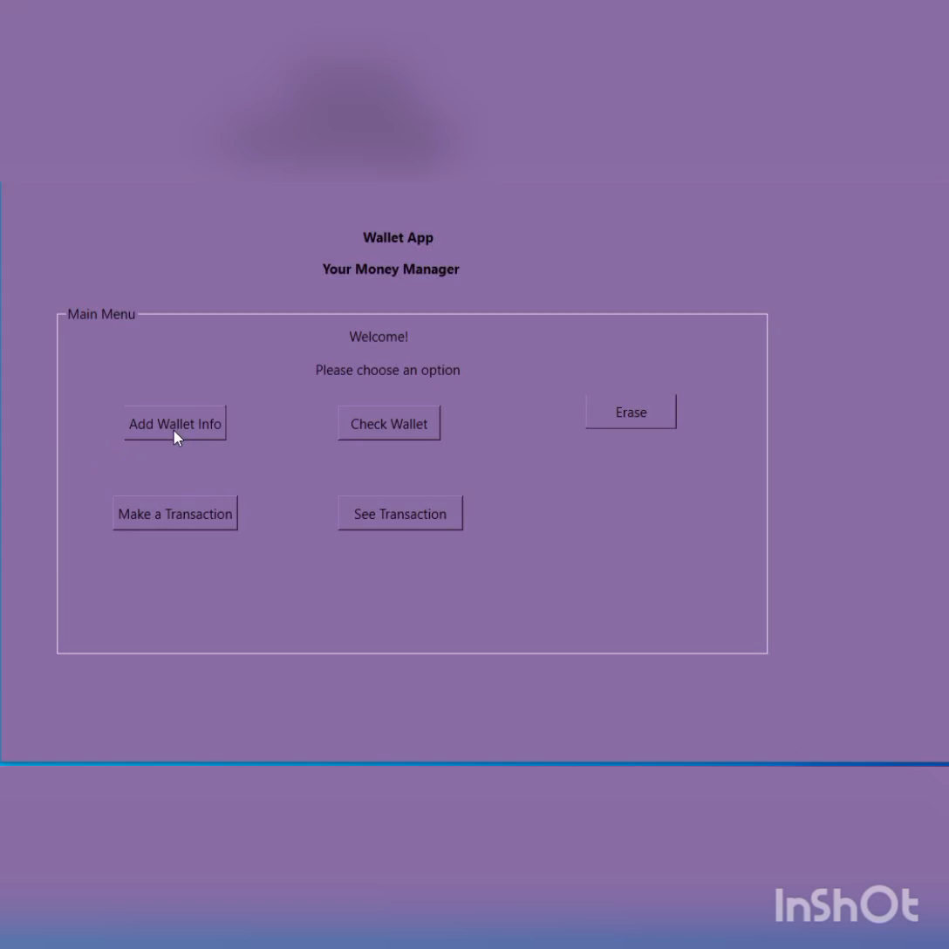
FINAL OUTPUT
25-07-2022 CSE 2188 : Software Engineering Sessional

Slide 18
THANK YOU
25-07-2022 CSE 2188 : Software Engineering Sessional

